Slide 1



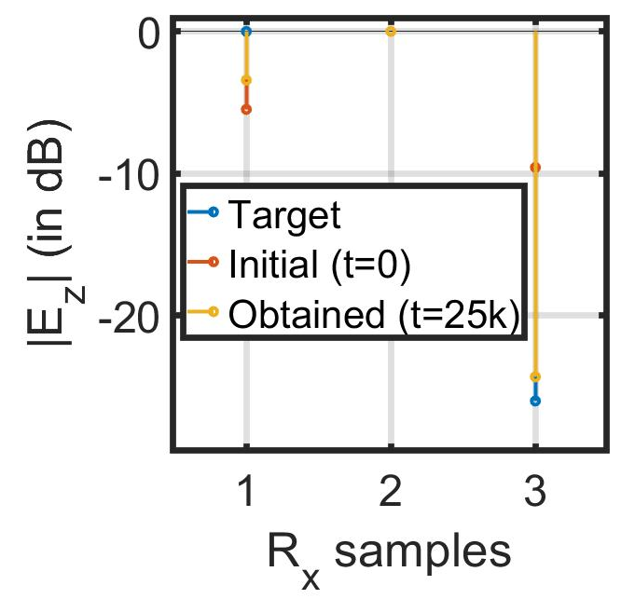
Securing Connected Vehicles, Soldiers, and Platforms in Contested Environments (CRA-4)
This research is supported by U.S. Army Grant No. W911NF2120076
1.6: Distributed Robotic Beamforming
K. Chakrabarti, A. S. Bedi, N. Chopra (UMD),
F. T. Dagefu, J. N. Twigg (ARL)
Objective: Autonomous multi-robots collaboratively form an antenna array to transmit a high-power directed signal while steering nulls through precise control of interference.
Acceleration due to the proposed IPG-DB algorithm enables rapid establishment of communication links.
Tested in a simulated urban environment of Los Angeles using 6 Tx, 2 target Rx, and 1 adversary.
Self-configuring IPG-DB algorithm controls Tx phase+amplitude for covert directional communication without Rx feedback.
~40% faster than traditional gradient-descent algorithm

